Slide 1


Slide 2
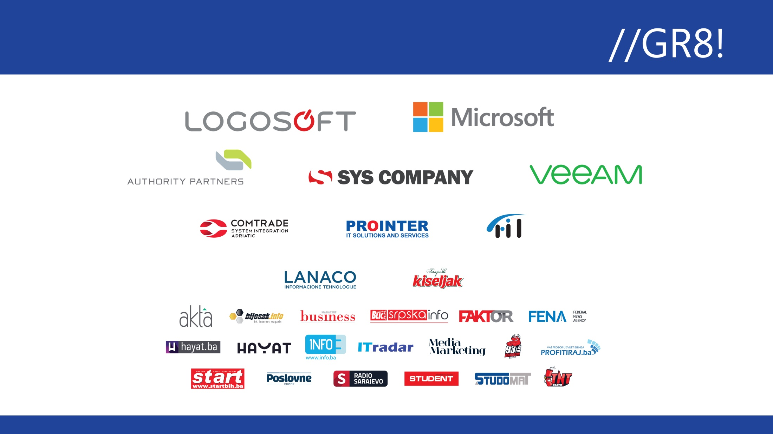
Infrastructure as Code, Terraform, PowerShell, ARM ili nešto treće

Slide 3


Let’s introduce my self
Ratomir Vukadin
DevOps Engineer – Mistral www.mistral.ba
https://www.linkedin.com/in/ratomir-vukadin-rvs/
https://twitter.com/Ratko_V
https://github.com/Ratomir
https://github.com/Ratomir/IaC.git
https://www.ratomirvukadin.com
Network 9, WinDays19, Azure Bootcamp, Tarabica19, Sinergija19…
Sarajevo MS Community 8
4-5th December 2019, ATD15

Slide 4

Today’s agenda
Infrastructure as Code
Different ways, how to deploy IaC to Azure
Pros/cons
ARM/Terraform/Pulumi side-by-side
Demo – deployment to Azure, Azure DevOps

Slide 5
Infrastructure as Code
Deployment of resources using templates
Resources are JSON objects
Customize the deployment parameterizing some of the property values
Very powerful; deploy large and complex architectures
Authoring is not for the faint of heart
Source Control

Slide 6



How to Get Started
Infrastructure as Code
People
Process
Products
Have a Vision
This is a big change
Iac/DevOps Movement
A way of life
Required to be successful
Simplicity
Modular
Flexible
Versioning
Powershell/Bash
Azure Quickstart Templates
VS Code
GitHub
Azure Automation, Ansible, VSTS

Slide 7
DevOps and IaC
Scripts / SDKs (automation)
Pros:
Process integration (DevOps / ITSM)
Removes human / less error prone
Unopinionated / total flexibility
Cons:
Requires scripting knowledge / environment
Complex logic needs to be hand built

Slide 8
Methods for Azure resource deployments
Azure Portal (manual)
Pros:
Browser based, quick setup, no fuss
Nice for exploration and visual inspection
Fully featured
Cons:
Everything is performed manually
Error prone
Lack of process integration (DevOps, ITSM)

Slide 9
Azure Resource Manager Templates
What are Azure Resource Manager Templates?
Written in JSON
Tooling for Visual Studio and Visual Studio Code
Native Azure portal integration
Generated directly from REST / Swagger

Slide 10
Azure Resource Manager Template Example
{
"$schema": "https://schema.management.azure.com/..json#",
"contentVersion": "1.0.0.0",
"parameters": {},
"variables": {},
"resources": [{
"type": "Microsoft.Resources/resourceGroups",
"apiVersion": "2018-05-01",
"location": "eastus",
"name": "demo-storage",
"properties": {}
},
{
"type": "Microsoft.Storage/storageAccounts",
"name": "demo-storage",
"apiVersion": "2018-02-01",
"location": "eastus",
"sku": {
"name": "Standard_LRS"
},
"kind": "Storage",
"properties": {}
}
]
}
Resource Group
Storage Account

Slide 11
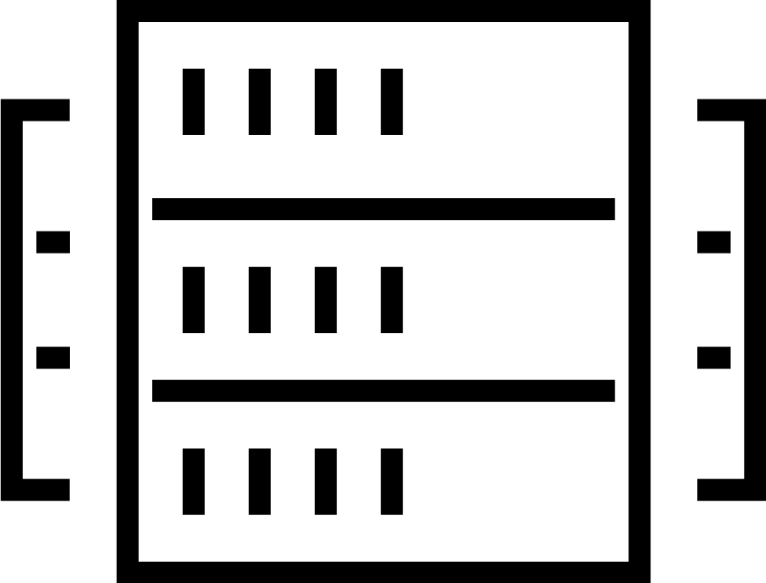





Multi-cloud infrastructure transition
TRADITIONAL DATACENTER
HYBRID DATACENTER
Application Platform
Security
Private cloud
AWS
Azure
GCP
Core Infrastructure
Notes:
In spite of what Docker will have you believe, containers and kubernetes haven’t homogenized the infra layer.
Customers want the best of all clouds private public or 3rd party. They don't want the JVM (lowest common denominator), but the Android (Open but can use best of each phone's hardware) approach.
So why should you care?
Heterogeneity - The challenge for customers moving to cloud is to enable automation through infrastructure as code while embracing the inevitable heterogeneity of different cloud providers that their polyglot app developers demand.
In traditional data center infra is essentially finite homogenous. Ops provision things across this finite pool upon which apps are deployed.
In Cloud, infra is essentially infinite and heterogenous. Each cloud provider provides a unique inventory of available infrastructure services. This heterogeneity is what gives each cloud its richness but also introduces tremendous complexity for developers who must learn the idiosyncrasies of provisioning each infrastructure type.
Talk about the diagram.

Slide 12


Terraform
What is Terraform?
Open source project
Cross computing environment templating language
Provision, Update, and Delete resources
Authored in HashiCorp Configuration Language (HCL) or JSON

Slide 13
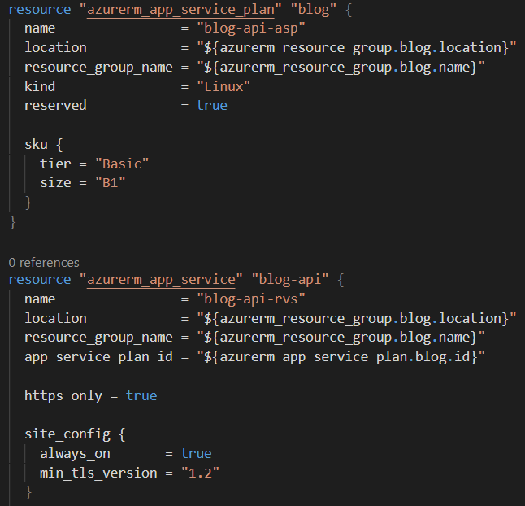
Terraform Example
App Service Plan
App Service

Slide 14
Terraform flow
Init
Plan
Apply
Destroy

Slide 15

Pulumi concept
Create modern applications.
Real programming languages. Define infrastructure in JavaScript, TypeScript, Python, or Go.
Your favorite tools. Use familiar IDEs, test frameworks, and tools.
Share and reuse. Codify best practices and share them with your team or a growing community of practitioners.

Slide 16

Pulumi deploy
Deploy to any cloud.
Many clouds, one workflow. Use the same language, tools, and workflow, no matter the cloud.
Collaborate. Harmonize your engineering practices between developers and operators.
Easy continuous delivery. Deploy from the CLI, or integrate with your favorite CI/CD system, and review all changes before they are made.

Slide 17
Pulumi flow
New
Preview
Up
Destroy

Slide 18

Demo

Slide 19

Pulumi vs Terraform
a new custom language, the HCL DSL
loops, functions, and classes
Terraform, state manually, by way of its “state files.” Pulumi - app.pulumi.com
Tf2pulumi - https://github.com/pulumi/tf2pulumi

Slide 20
Get started with Pulumi
https://www.pulumi.com/azure/
https://github.com/pulumi/examples
https://mikhail.io/
@MikhailShilkov

Slide 21
Q/A?
Q/A?
Q/A?
Q/A?
Q/A?
Q/A?

Slide 22
HVALA NA PAŽNJI!

